Slide 1
Secure Routing for Mobile Ad Hoc Networks
Ravindranath Gummadidala
Palaniappan Sathappa
CSE620

Slide 2
Overview
Introduction
MANETs
Routing Protocols for MANETs
  DSR
  AODV
  DSDV
Exploits allowed by existing protocols

Slide 3
Overview (contd.)
Secure Routing Protocols
  ARAN
  SRP
  TESLA
  ARIADNE
  TIK
  SAR

Slide 4
Overview (contd.)
  Watchdog and Pathrater
  Byzantine Resistant
  CONFIDANT
  SEAD
Conclusions
References

Slide 5
MANETs
A group of wireless mobile computers (nodes)
Nodes cooperate by forwarding packets for each other
Need no fixed network infrastructure
Can be quickly and inexpensively setup
Applications: military exercises, disaster relief, mine site operations, etc

Slide 6
Routing Protocols for MANETs
Table based (proactive)
  DSDV
On-demand (reactive)
  DSR
  AODV
Hybrid

Slide 7
DSR
Dynamic Source Routing
An on-demand ad hoc network routing protocol composed of two parts:
  Route discovery
  Route maintenance

Slide 8
DSR Route Discovery
Initiator transmits ROUTE REQUEST (RREQ) packet as local broadcast specifying target and a unique identifier from the initiator
Each node receiving the RREQ discards the request if it has seen the request identifier from the originator

Slide 9
DSR Route Discovery (contd.)
Otherwise it appends its node address to a list in RREQ and rebroadcasts the RREQ
When RREQ reaches target, target sends ROUTE REPLY (RREP) back to initiator of RREQ with a copy of the accumulated address list from RREQ

Slide 10
DSR Route Maintenance
DSR is a source routing protocol
Path to be followed included in the packet header
If a node on path does not get an ack after a limited number of local retransmissions it returns ROUTE ERROR (RERR) back to originator identifying the broken link

Slide 11
DSR Route Maintenance (contd.)
Originator then removes path containing broken link from cache
May use an alternate route to destination if one exists in cache
Else it initiates a new route discovery

Slide 12
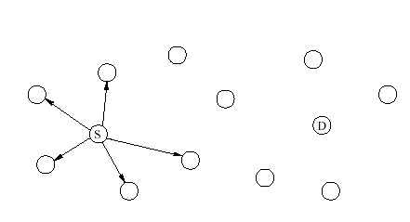
Example of DSR

Slide 13
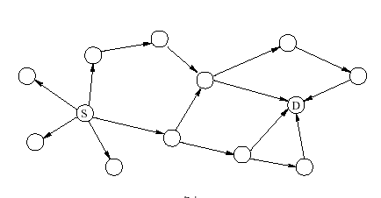
Example of DSR

Slide 14
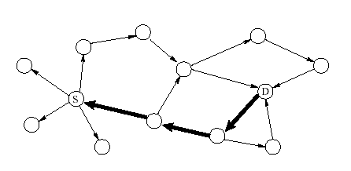
Example of DSR

Slide 15
AODV
Ad Hoc On Demand Distance Vector Routing
AODV builds routes using a route request / route reply query cycle
In addition to the source node's IP address, current sequence number, and broadcast ID, the RREQ also contains the most recent sequence number for the destination of which the source node is aware.

Slide 16
AODV (contd.)
A node receiving the RREQ may send a route reply (RREP) if it is either the destination or if it has a route to the destination with corresponding sequence number greater than or equal to that contained in the RREQ
if yes it unicasts RREP back to source
else it rebroadcasts RREQ
If the source later receives a RREP containing a greater sequence number or contains the same sequence number with a smaller hop count, it updates its routing information for that destination.

Slide 17
AODV (contd.)
Once the source stops sending data packets, the links will time out and eventually be deleted from the intermediate node routing tables
If a link break occurs while the route is active, the node upstream of the break propagates a route error (RERR) message to the source node to inform it of the now unreachable destination(s). After receiving the RERR, if the source node still desires the route, it can reinitiate route discovery.

Slide 18
Exploits allowed by existing protocols
Attacks using modification
  Redirection by modified route sequence numbers
  Redirection with modified hop counts
  DoS with modified source routes
  Tunneling

Slide 19
Exploits allowed by existing protocols (contd.)
Attacks using impersonation
  Forming loops by spoofing
Attacks using fabrication
  Falsifying route errors in AODV and DSR
  Route cache poisoning in DSR

Slide 20
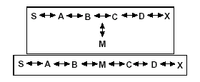
Redirection by modified route sequence numbers

Slide 21
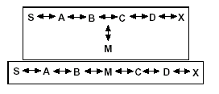
DoS with modified source routes

Slide 22
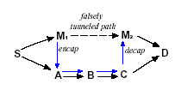
Tunneling

Slide 23

Forming loops by spoofing

Slide 24

Forming loops by spoofing

Slide 25
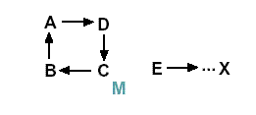
Forming loops by spoofing

Slide 26
Falsifying Route Errors in AODV and DSR

Slide 27
Route Cache Poisoning in DSR
In addition to learning routes from headers of packets that a node processes along a path routes may be learned from promiscuously received packets
A node overhearing any packet may add routing information contained in that packets header to its own route cache even if it is not on the path from source to destination

Slide 28
Secure Routing Protocols
Route signaling cannot be spoofed
Fabricated routing messages cannot be injected into the network
Routing messages cannot be altered in transit except according to the normal functionality of the routing protocol
Routing loops cannot be formed through malicious actions

Slide 29
Secure Routing Protocols (contd.)
Routes cannot be redirected from shortest path through malicious actions
Unauthorized nodes should be excluded from route computation and discovery

Slide 30
ARAN
Authenticated Routing for Ad hoc Networks
Components
  Certification
  Authenticated route discovery
  Authenticated route setup
  Route maintenance
  Key revocation

Slide 31
Certification
Requires use of trusted certificate server T
Before entering network each node needs to request a certificate from T
Node A receives certificate as:
T->A :cert_{A}=[IP_{A} ,K_{A+} ,t ,e] K_{T-}

Slide 32
Authenticated route discovery
Source A begins route instantiation to destination X by broadcasting a route discovery packet (RDP):
A->brdcst:[RDP, IP_{X}, cert_{A}, N_{A}, t] K_{A-}
Let B be the neighbor that receives the RDP which it subsequently rebroadcasts
B->brdcst:[[RDP, IP_{X}, cert_{A}, N_{A}, t] K_{A-}] K_{B-}, cert_{B}

Slide 33
Authenticated route discovery
Let C be the neighbor that receives Bs broadcast. C subsequently broadcasts
C->brdcst:[[RDP, IP_{X}, cert_{A}, N_{A}, t] K_{A-}] K_{C-},cert_{C}
Each node along the path repeats these steps of validating previous node’s signature, removing the previous node’s certificate and signature, recording the previous node’s IP address, signing the original contents of the message, appending its own certificate and forward broadcasting the message

Slide 34
Authenticated Route Setup
After receiving RDP destination unicasts a reply REP packet back along reverse path to source. Let D be the first node that receives the REP sent by X
X->D:[REP,IPa,certX,Na,t] Kx-
Let D’s next hop to source be C
D->C:[[REP,IPa,certX,Na,t]Kx-]Kd,certD
C->B:[[REP,Ipa,certX,Na,t]Kx-]Kc-,certC
When source receives REP it verifies destination’s signature and nonce returned by the destination.

Slide 35
Route Maintenance
When no traffic occurs on an existing route for sometime that route is deactivated in routing table
Data received on an inactive route causes nodes to generate Error (ERR) messages that travel the reverse path towards the source
Nodes also use ERR to report links in active routes that break due to node movement.
All ERR messages must be signed
B->C:[ERR,IPa,IPx,certB,Nb,t]Kb-
Nonce and timestamp ensure ERR message is fresh.

Slide 36
Key revocation
In the event that a certificate needs to be revoked the trusted certificate server T sends a broadcast message to the ad hoc group announcing the revocation
T-> brdcst : [revoke,certR] Kt-
Nodes receiving this message re-broadcasts it to its neighbors
Neighbors of nodes with revoked certificates need to reform routing as necessary to avoid transmission through the now untrusted node.

Slide 37
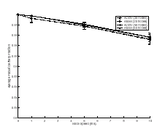
Simulation Results (average packet delivery fraction)

Slide 38
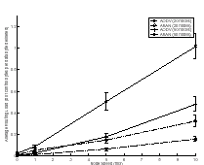
Simulation Results (average routing load bytes)

Slide 39
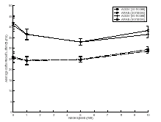
Simulation Results (average data packet latency)

Slide 40
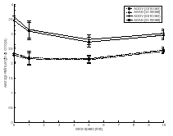
Simulation Results (average path length)

Slide 41
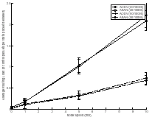
Simulation Results (average routing load packets)

Slide 42
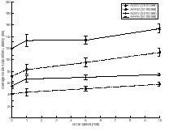
Simulation Results (average route acquisition latency)

Slide 43
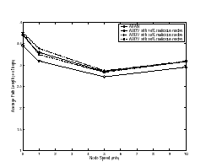
Simulation Results (average path length)

Slide 44
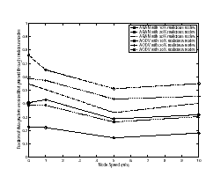
Simulation Results (fraction of data packets malicious nodes)

Slide 45
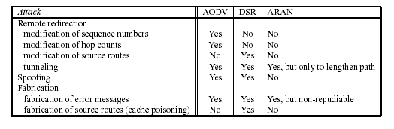
Summary of ARAN

Slide 46
SRP
Secure Routing Protocol
Assumptions
  Security association between S and T assumed K_{S,T} (bidirectional)
  Adversarial nodes exhibit Byzantine behavior
  Bidirectional links
  Promiscuous mode operation

Slide 47
Overview of SRP
S initiates route discovery by constructing route request packet identified by query sequence number and random query identifier
Source, destination and query ID used as input for MAC calculation with K_{S,T}
Identities of traversed nodes accumulated in route request packet.

Slide 48
Overview of SRP (contd.)
Intermediate nodes discard previously seen route requests
Destination T constructs route reply; calculates MAC covering route reply contents and returns packet to S
Multiple replies may reach S
S validates replies and updates its topology view

Slide 49
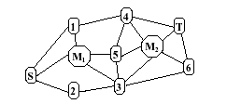
Scenario 1
say when M1 receives {Qs,t:S} it generates {Rs,t:S,M1,T}

Slide 50
Scenario 2
M1 discards route request packets arriving from its neighbors

Slide 51
Scenario 3
M1 sees and relays {Qs,t:S,1,M1}; upon arrival of {Qs,t:S,1,M1,5,4} at T reply is generated and sent on reverse path. when M1 receives {Rs,t:S,1,M1,5,4,T} it tampers and relays {Rs,t:S,1,M1,Y,T} Y being invented sequence of nodes

Slide 52
Scenario 4
M2 receives {Qs,t:S,2,3} relays {Qs,t:S,X,3,M2} where X is a false IP address. T sends the reply {Rs,t:S,X,3,M2,T}. when 3 receives reply reply is dropped

Slide 53
Scenario 5
M1 replays route requests to consume network resources. discarded by intermediate nodes due to query identifiers. query sequence number takes care of case when replay occurs after a significant period of time

Slide 54
Scenario 6
M1 after seeing several RREQ from S fabricates queries with subsequent query identifiers to result in intermediate nodes discarding legitimate future route requests.

Slide 55
Possible attack against SRP
Nodes collude during the two phases of single route discovery
E.g. M1 receives request tunnels it to M2, M2 broadcasts request with path between M1 and M2 falsified e.g. {Qs,t:S,M1,Z,M2}. T constructs reply and routes over {T,M2,Z,M1,S}. M2 tunnels reply to M1 thus completing attack

Slide 56
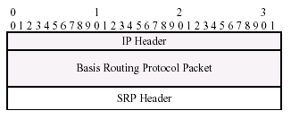
Detailed protocol description
SRP extension of a reactive routing protocol

Slide 57
Route Request
Query sequence number allows destination to detect outdated route requests
Randomly computed Query identifier used to combat attack where malicious nodes broadcast fabricated requests to cause subsequent legitimate queries to be discarded
RREQ fields that get updated as packet propagates to destination and IP header mutable fields excluded from MAC computation.

Slide 58
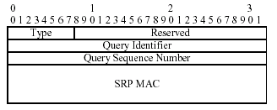
SRP Header

Slide 59
Query Handling/Propagation
Intermediate nodes parse requests to determine if SRP header present
If not process packet as described by basis protocol specification
Else extract Qid, source and destination address and determine if query previously seen if yes discard query else rebroadcast
Also measure frequencies of queries received from neighbors to regulate query propagation process.

Slide 60
Query Handling/Propagation (contd.)
Give highest priority to nodes generating requests at the lowest rates and lowest priority to nodes generating queries at higher rates
Quanta allocated proportionally to priority and within each class round-robin servicing.

Slide 61
Route Reply
T validates the received route request packet by first verifying that it originated from a node with which it has a security binding
Qseq is compared to Smax, the maximum sequence number received from S within the lifetime of the SA
If Qseq <= Smax request discarded
Else T calculates keyed hah of request fields
If output matches SRP header MAC integrity and authenticity verified

Slide 62
Route Reply (contd.)
For every valid request T places accumulated route in route reply packet and the Qid and Qsec of the route request in the corresponding SRP header fields.
MAC covers basis protocol route reply and rest of SRP header to provide message integrity and authentication

Slide 63
Route Reply Validation
On reception of Route Reply, S checks the source and destination addresses, Qid and Qsec and discards the route reply if it does not correspond to the currently pending query.
Otherwise it compares reply IP source-route with the reverse of the route carried in reply payload
If the two match S calculates MAC using replied route, SRP header fields and Ks,t.
If MACs match validation complete.

Slide 64
Intermediate Node Replies
Route caching not encouraged and in general intermediate nodes not required to provide route replies.
Route caching can improve effectiveness of route discovery process
Hence if and intermediate node V has an active route to T and a SA exists between S and V then a reply can be provided to S
This extension enabled by Intermediate Node Reply Token (INRT)

Slide 65
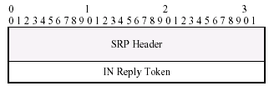
Extended SRP Header

Slide 66
Route Maintenance
Route error messages are source routed along prefix of route reported as broken and S compares route traversed by error messages to the prefix of the corresponding route.
Thus it can verify that route error feedback provided refers to actual route and is not generated by a node that is not part of the route

Slide 67
TESLA
Broadcast authentication protocol
Timed Efficient Stream Loss-tolerant Authentication
sender chooses a random initial key Kn and generates a one-way hash function H on this value:
K _{n-1}=H(K_{n}); K_{n-2}=H(K_{n-1})...
sender predetermines a schedule at which it discloses each key of its one-way key chain in the reverse order from generation i.e. K₀,K₁,K₂,...

Slide 68
TESLA
Loose time synchronization between sender and receiver
when receiver receives a packet it verifies security condition i.e key K_{i} used to authenticate packet cannot yet have been disclosed
if yes receiver buffers packet and waits for sender to disclose K_{i} while using disclosed key to authenticate buffered packets
if no it drops packet

Slide 69
ARIADNE
An on demand secure routing protocol based on TESLA broadcast authentication protocol
Further based on DSR

Slide 70
Network Assumptions
Network links are bi-directional
Network may drop, corrupt, reorder or duplicate packets in transmission
Each node must be able to estimate end-to-end transmission time to any other node in the network

Slide 71
Node Assumptions
Nodes may vary greatly in terms of resources hence it is assumed that nodes have few resources and hence asymmetric cryptography may be unsuitable for such resource constrained nodes

Slide 72
Key Setup Assumptions
A mechanism to setup shared secret keys between communicating nodes
A mechanism to distribute one authentic public TESLA key for each node

Slide 73
Notation
A, B are principals such as communicating nodes
K_{AB} and K_{BA} denote secret MAC keys shared between A and B
MAC K_{AB}(M) denotes computation of message authentication code of M with MAC key K_{AB}

Slide 74
Ariadne Route Discovery
Route discovery has two stages: initiator floods the network with ROUTE REQUEST and the target returns a ROUTE REPLY.
To secure the Route Request packet Ariadne provides the following properties:
  Target node can authenticate initiator
  Initiator can authenticate each entry of the path in ROUTE REPLY
  No intermediate node can remove a previous node in the node list in Requestor REPLY

Slide 75
Ariadne Route Discovery
ROUTE REQUEST packet contains eight fields:
<RREQ,initiator,target,id,time interval,hash chain,node list, MAC list>
When a node A receives RREQ for which it is not target it checks its table for <initiator,id> values and discards packet if match found
It then checks whether time interval is valid
If not discards packet

Slide 76
Ariadne Route Discovery
Else it modifies RREQ by appending its own address to node list, replacing the hash chain with H[A,hash chain] and appending a MAC of the entire request to the MAC list using key Kai
When target receives RREQ it checks validity by determining keys from time interval specified have not yet been disclosed and that hash chain filed is equal to
H[Nn, H[Nn-1, H[…,H[N1, MACKSD(initiator,target,id,time interval)]…]]]

Slide 77
Ariadne Route Discovery
If RREQ valid RREP returned as
<RREP,target,initiator,time interval,node list,MAC list,target MAC,key list>
RREP returned to initiator of RREQ along source route obtained by reversing node list of the RREQ
Node forwarding RREP waits till it can disclose its key from specified time interval; it then appends that key to key list and forwards packet
Initiator verifies each key in key list is valid and target MAC is valid and that each MAC in MAC list is valid

Slide 78
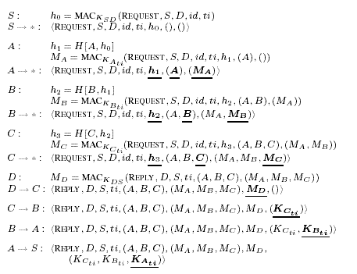
An example

Slide 79
Ariadne Route Maintenance
Node forwarding packet to next hop along source route returns Route ERROR to original sender of packet if it is unable to deliver packet after a limited number of retransmissions
ERROR needs to be authenticated by sender
Each node on return path to source forwards the ERROR

Slide 80
Ariadne optimization
Route caching possible
In basic Ariadne only initiator of discovery can use route since target MAC can only be verified by the initiator.
If however appropriate data is broadcast authenticated any node along return path can use that route to reach target

Slide 81
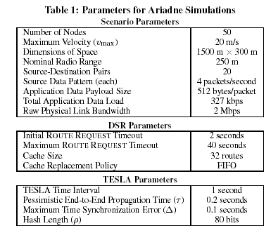
Simulation Parameters

Slide 82
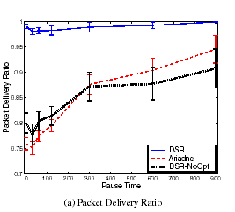
Simulation Results

Slide 83
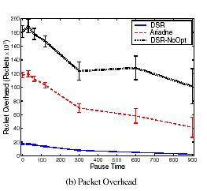
Simulation Results

Slide 84
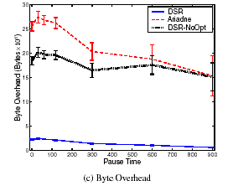
Simulation Results

Slide 85
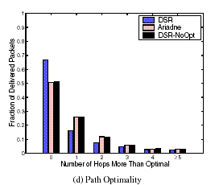
Simulation Results

Slide 86
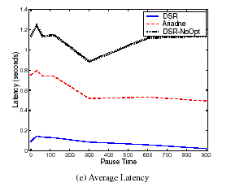
Simulation Results

Slide 87
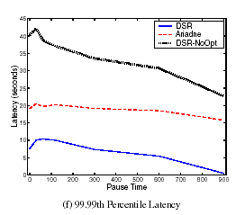
Simulation Results

Slide 88
TIK
Tesla with Instant Key Disclosure
Receiver can verify TESLA security condition as it receives the packet thereby eliminating the authentication delay of TESLA
Allows sender to disclose key in the same packet
Implements temporal leash thus allowing receiver to detect wormhole attacks

Slide 89
TIK (contd.)
Requires accurate time synchronization between all communicating parties
Each node needs to know just one public value for each sender node enabling scalable key distribution

Slide 90
TIK (contd.)
Stages of TIK
  Sender setup
  Receiver bootstrapping
  Sending and verifying authenticated packets

Slide 91
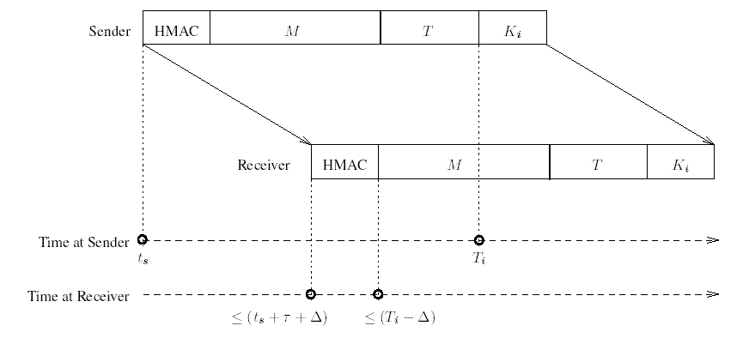
Timing Diagram

Slide 92
Sender setup
Sender uses pseudo-random function and a secret master key to derive a series of keys K₀,K₁,K₂,K₃...
Sender selects uniformly distributed points in time when each key is published T₀ disclosure time for K₀ and T_{disc} is interdisclosure time
Sender constructs merkle hash tree and computes root m

Slide 93
Receiver bootstrapping
All nodes have synchronized clocks with a maximum clock synchronization error Δ
Each receiver knows every senders hash tree root m and associated parameters T₀ and T_{disc}

Slide 94
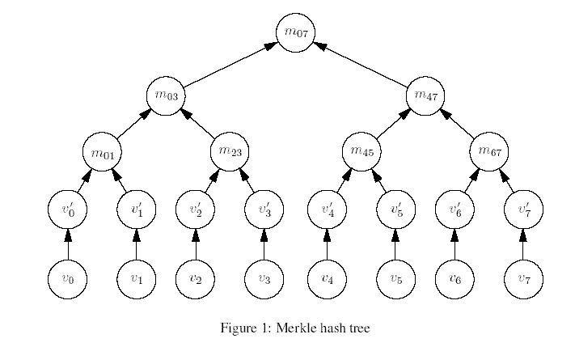
Merkle Hash Tree

Slide 95
Sending and verifying authenticated packets
TIK packet is transmitted as:
S->R:< HMAC_{Ki}(M), M, T, Ki >
Explicit expiration timestamp added to each packet for implementing temporal leash
If perceived transit time exceeds a threshold discard packet

Slide 96
Conclusions
Examined the need for secure routing protocols
Stressed the need for symmetric cryptography in MANETs
Looked at a number of secure routing protocols for MANETs
Looked at areas of future research

Slide 97
References
Bridget Dahill, Brian Neil Levine, Elizabeth Royer, Clay Shields. A Secure Routing Protocol for Ad Hoc Networks
Yih-Chun Hu, Adrian Perrig, David B Johnson. Ariadne: A secure on demand routing protocol for Ad hoc networks
Segio Marti, T J Giuli, Kevin Lai, Mary Baker. Mitigating routing misbehavior in mobile ad hoc networks
Panagitiotis Papadimitrois, Zygmunt Haas. Secure routing for mobile ad hoc networks

Slide 98
References (contd.)
Seung Yi, Prasad Naldurg, Robin Kravetas. A security aware ad hoc routing protocol for wireless networks
Yin-Chun Hu, David Johnson , Adrian Perrig. SEAD:secure efficient distance vector routing fore mobile wireless ad hoc networks
Sonja Buchegger, Jean Yves Le Boudec. Nodes bearing grudges: towards routing security, fairness and robustness in mobile ad hoc networks

Slide 99
References (contd.)
Baruch Awerbuch, David Holmer, Crisitina Nita-Rotaru, Herbert Rubens. An on demand routing protocol resilient to Byzantine failures
Yih-Chun Hu, Adrian Perrig, David Johnson. Wormhole detection in wireless ad hoc networks

